Slide 1
What is Agile and Scrum?
Notes:
Agile: able to move quickly and easily.
Agile is a process that helps teams provide quick and unpredictable responses to the feedback they receive on their project.

Slide 2
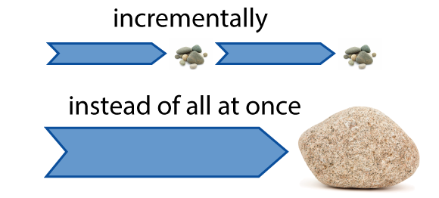
What is Agile?
Agile: able to move quickly and easily.
agile development is a different way of managing development teams and projects.
Agile is a process that helps teams provide quick and unpredictable responses to the feedback they receive on their project.
Iterative approach
Notes:
Agile: able to move quickly and easily.
Agile is a process that helps teams provide quick and unpredictable responses to the feedback they receive on their project.

Slide 3
Agile manifesto
Individuals and interactions over processes and tools
in agile development, self-organization and motivation are important, as are
interactions like co-location and pair programming.
Working software over comprehensive documentation
working software will be more useful and welcome than just presenting documents to clients in meetings.
Customer collaboration over contract negotiation
requirements cannot be fully collected at the beginning of the software development cycle, therefore continuous customer or stakeholder involvement is very important.
Responding to change over following a plan
agile development is focused on quick responses to change and continuous development
Notes:
Agile: able to move quickly and easily.
Agile is a process that helps teams provide quick and unpredictable responses to the feedback they receive on their project.

Slide 4
Agile principles
1. Customer satisfaction by rapid delivery of useful software
2. Welcome changing requirements, even late in development
3. Working software is delivered frequently (weeks rather than months)
4. Close, daily cooperation between business people and developers
5. Projects are built around motivated individuals, who should be trusted
6. Face-to-face conversation is the best form of communication (co-location)
7. Working software is the principal measure of progress
8. Sustainable development, able to maintain a constant pace
9. Continuous attention to technical excellence and good design
10. Simplicity—the art of maximizing the amount of work not done—is essential
11. Self-organizing teams
12. Regular adaptation to changing circumstances
Notes:
Agile: able to move quickly and easily.
Agile is a process that helps teams provide quick and unpredictable responses to the feedback they receive on their project.

Slide 5
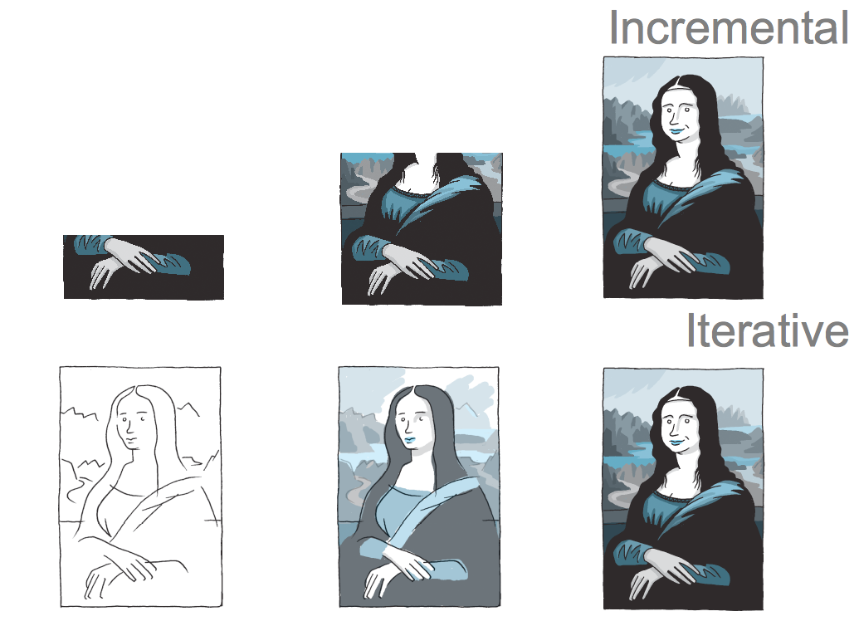
Iterative vs. Waterfall
Notes:
One of the differences between agile and waterfall is that testing of the software is conducted at different stages during the software development lifecycle. In the Waterfall model, there is always a separate testing phase near the completion of an implementation phase. However, in Agile and especially Extreme programming, testing is usually done concurrently with coding, or at least, testing jobs start in early iterations.

Slide 6
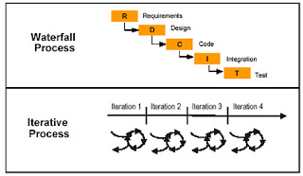
Iterative vs. Waterfall
Notes:
One of the differences between agile and waterfall is that testing of the software is conducted at different stages during the software development lifecycle. In the Waterfall model, there is always a separate testing phase near the completion of an implementation phase. However, in Agile and especially Extreme programming, testing is usually done concurrently with coding, or at least, testing jobs start in early iterations.

Slide 7
Code vs. Documentation
"Working software over comprehensive documentation" as "We want to spend all our time coding. Remember, real programmers don’t write documentation."
Notes:
"Working software over comprehensive documentation" as "We want to spend all our time coding. Remember, real programmers don’t write documentation."

Slide 8
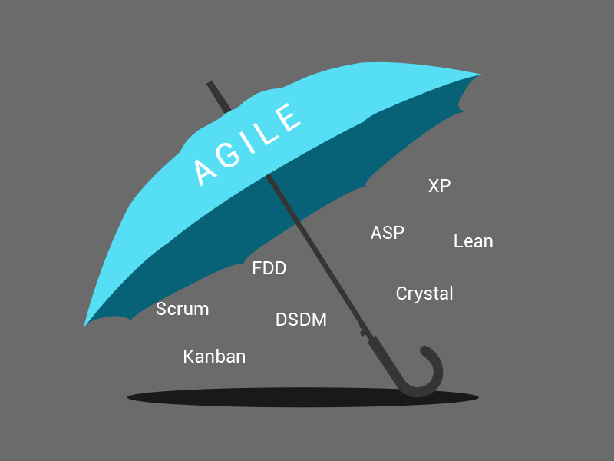
Agile methods
Notes:
1. Adaptive Software Development (ASD)
2. Agile Modeling
3. Agile Unified Process (AUP)
4. Crystal Methods (Crystal Clear)
5. Disciplined Agile Delivery
6. Dynamic Systems Development Method (DSDM)
7. Extreme Programming (XP)
8. Feature Driven Development (FDD)
9. Lean software development
10. Kanban
11. Scrum
12. Scrum-ban

Slide 9
The Benefits of Agile Software Development
Stakeholder Engagement and Satisfaction
Transparency
Early and Predictable Delivery
Predictable Costs and Schedule
Flexible Prioritization
Allows for Change
Focuses on Business Value
Focuses on Users
Improves Quality
It gives your team Purpose
Notes:
https://luis-goncalves.com/what-is-agile-methodology/
Top software developers developed agile meetings. After repeatedly experiencing challenges and limitations from traditional waterfall development in real life projects, they wanted to create a more efficient process for analyzing project development. The approach they used addresses the issues regarding the philosophies and processes of traditional methods directly.
There are many benefits to the agile software development. They include:
Stakeholder Engagement and Satisfaction
The agile process creates many opportunities throughout each sprint meeting for genuine engagement between the team and the stakeholders. Because the client is actively involved in the entire project, there is a continuous level of collaboration between all parties. This gives the team a chance to fully understand the client’s vision. By delivering high quality, working software frequently, the stakeholders quickly develop a trusting and authentic relationship with the team. This also further promotes engagement between the client and the team.
Transparency
The agile approach actively involves the client throughout the entire project including the iteration planning, review sessions, and new feature builds in the software. Clients, however, must understand that during the transparency of the project, they are seeing a work in progress and not the final product.
Early and Predictable Delivery
Sprints are held on a fixed schedule of 1 to 4 weeks duration. By using this time-boxed method, predictability is high as new features can be delivered to the stakeholders quickly and frequently. It also allows the team to beta test or release the software sooner if it has sufficient business value.
Predictable Costs and Schedule
Because the Sprints are on a fixed schedule, the costs are limited and predictable, and based on the amount of work done. By combining the estimated costs before each Sprint, the client will better understand the approximate costs of each feature. This offers more improved decision-making opportunities when prioritizing the features or adding iterations.
Flexible Prioritization
Scrum methodologies allow more flexibility by prioritizing the customer-driven features. The team has more control in managing the shippable units of work with each sprint boundary; making continued progress towards the final product milestone. To get a prompt RIO from the engineering, the work needs to be shipped early to the customers so they will realize the value from the features.
Allows for Change
While the focus should be to deliver the agreed subset of the products features, Agile processes create an opportunity to continually reprioritize and refine the product backlog. These changes can be added to the next iteration so the new changes can be introduced within a few weeks.
Focuses on Business Value
The team has a better understanding of what is most important for the client’s business and can deliver features that give the most value to the business.
Focuses on Users
The user’s stories are commonly used to define the product features as they relate to business-focused acceptance criteria. By focusing on the user’s needs, each feature delivers real value and not just an IT component. It provides a better opportunity to gain valuable feedback through beta testing the software after each Sprint. This provides vital feedback earlier in the project so that changes can be made as needed.
Improves Quality
The projects are broken down into manageable units, making it easier for the team or focus on high-quality development, testing, and collaboration. By creating builds and conducts tests or reviews throughout the iteration, defects and mismatches can be found and fixed early, improving over-all quality.
It gives your team Purpose
Most agile processes focus on creating a shared sense of ownership and goals for all team members. This to gives your team purpose rather than creating a false sense of urgency. Purposeful teams are more productive and challenge themselves to be faster and more efficient.

Slide 10
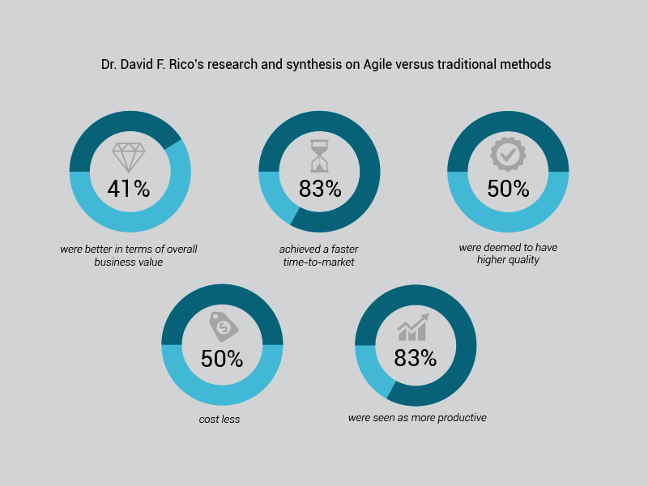
The Business Benefits of Agile
Notes:
https://luis-goncalves.com/what-is-agile-methodology/
41% were better in terms of overall business value
83% showed quicker time-to-market speeds
50% were higher in quality
50% were less costly
83% were more productive

Slide 11
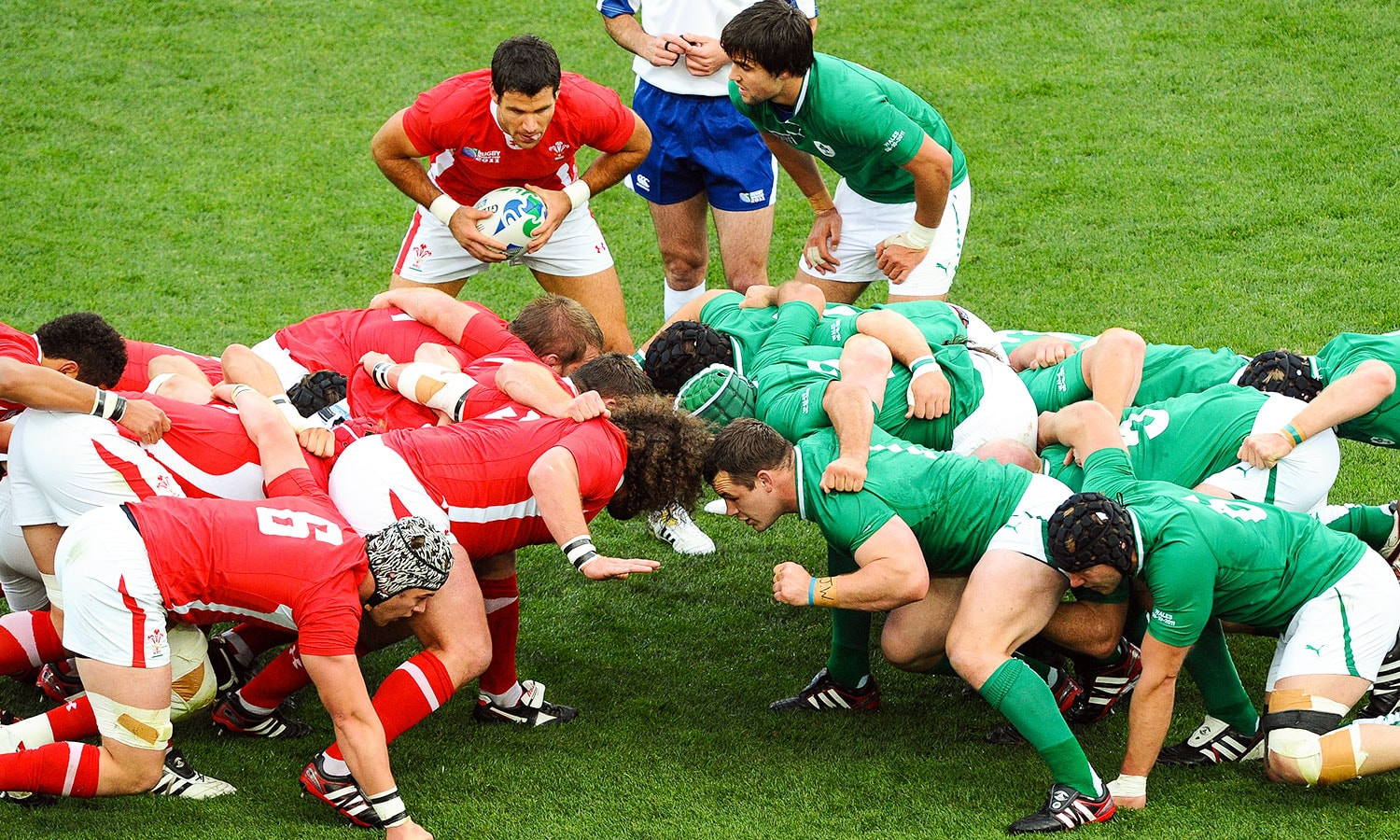
What is Scrum?
Notes:
RUGBY
an ordered formation of players, used to restart play, in which the forwards of a team form up with arms interlocked and heads down, and push forward against a similar group from the opposing side. The ball is thrown into the scrum and the players try to gain possession of it by kicking it backwards towards their own side.

Slide 12
What is Scrum?
Scrum is a framework within which people can address complex adaptive problems, while productively and creatively delivering products of the highest possible value.
Scrum itself is a simple framework for effective team collaboration on complex products.
Scrum is:
Lightweight
Simple to understand
Difficult to master

Slide 13
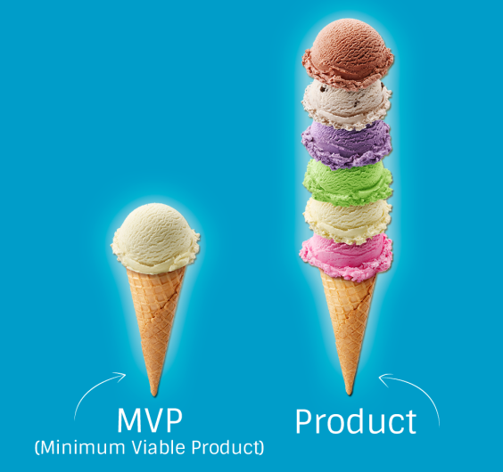
Why Scrum?
MVP (minimum viable product)

Slide 14
Scrum vs. Traditionnel Project Management
….

Slide 15
Scrum has been used by
Microsoft
Yahoo
Google
Electronic Arts
High Moon Studios
Lockheed Martin
Philips
Siemens
Nokia
Capital One
BBC
Intuit
Intuit
Nielsen Media
First American Real Estate
BMC Software
Ipswitch
John Deere
Lexis Nexis
Sabre
Salesforce.com
Time Warner
Turner Broadcasting
Oce

Slide 16

Scrum framework
Roles
Product owner
ScrumMaster
Team
Ceremonies
Sprint planning
Sprint review
Sprint retrospective
Daily scrum meeting
Artifacts
Product backlog
Sprint backlog
Burndown charts

Slide 17
Roles
Scrum Team comprises of
Scrum Master (SM)
Product Owner (PO)
Development Team (Cross-functional professionals)

Slide 18
Scrum Events
Sprint Planning
Daily Scrum
Sprint Review
Sprint Retrospective Refinement Meetings

Slide 19
Artifacts
Product Backlog
Sprint Backlog
Task Dashbord
Burndown charts

Slide 20
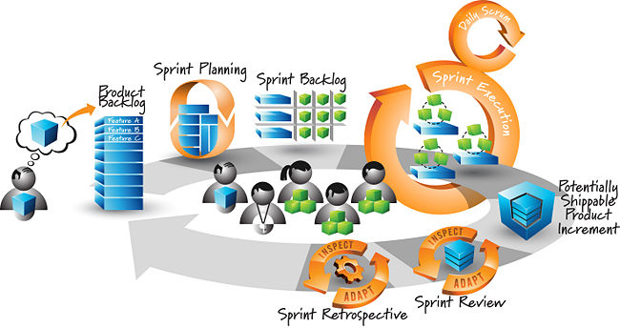
Agile Scrum

Slide 21
“Scrum is kind of like poker; you can learn the rules in 10 minutes, but it takes a long time to get great at it.”
Agile Scrum

Slide 22
Agile Scrum Content
1st day: Scrum Overview
2nd day: Scrum Roles and Scrum Artifacts
3rd day: Scrum Events and Estimation

